Slide 1

Practical GitHub Actions
Warren Blanchet

Slide 2
Software helping to write software
CI/CD
Software helping to build, test, and deploy software
DevOps tooling
Automation of processes:
Performs work consistently: time and cost
Frees up personnel for higher-value work
Tools at GitHub:
GitHub actions
Dependabot

Slide 3
GitHub action workflows overview
Composable Components
Other GitHub actions
Orchestrated in a workflow represented as a YAML file that lives with the code
Scripts
Shell, JavaScript, etc.
Containers
Virtual Machines

Slide 4

GitHub Dependabot overview
Looks for things in your application that have new versions
Java (Maven, Gradle)
JavaScript (npm, yarn)
Python (pip, poetry, …)
Docker
GitHub Actions
…
Just another member of your team
Opens pull requests
Responds to (specifically worded) comments in the PRs

Slide 5

GitHub action workflows
Working example

Slide 6
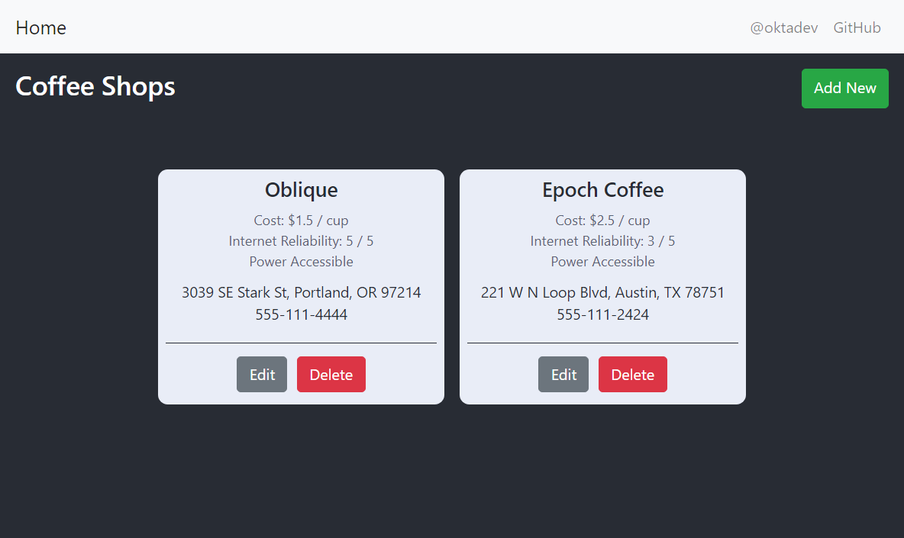
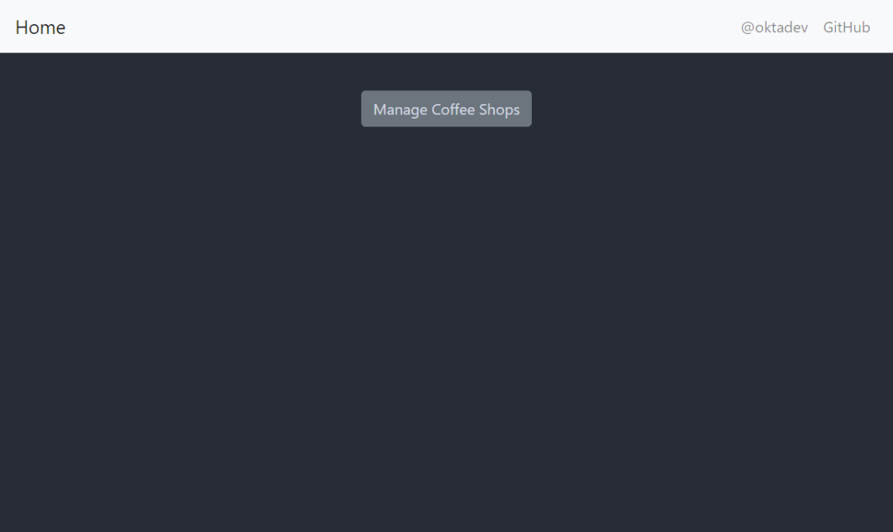
Our example app

Slide 7
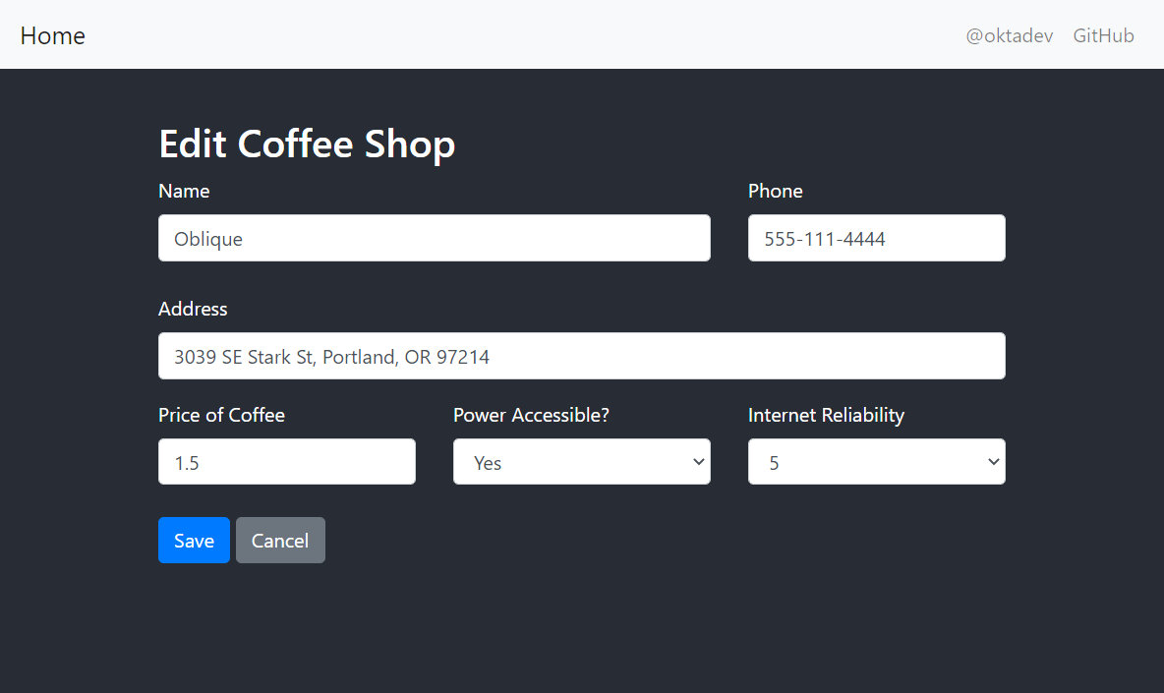
Our example app (2)
A React frontend with a Kotlin backend
Uses a multi-stage Dockerfile to build and test
Has integration tests written in Playwright
Likely deployed as a container
(not shown as part of example)

Slide 8
Build and test
Every time you push:
Build software
Run tests
Publish results
We’ll use GitHub pages as a destination

Slide 9
Build and test – how
YAML
Trigger
Can have multiple triggers
Some filtering
Jobs and Steps
Steps: sequence of tasks run in jobs, share workspace & VM
Jobs: parallel execution, different VMs

Slide 10
Build and test – how (2)
First job: build container using Dockerfile
Also just export files for Windows
Can’t run nested VMs, unless you have your own server
Use artifact to pass between jobs
Cache configuration – important for fast execution
setup-<node|java|…> actions include caching setup

Slide 11
Build and test – how (3)
Second job
Integration test on Linux and Windows
Need to wait for previous step
Double-curly bracket for GitHub context references
Publish to GitHub Pages
Changes by action runner can’t trigger more workflows (avoids infinite loops)
Secrets (edited in GUI) can be set up to pass information into the actions

Slide 12
Build and test – how (4)
Index pages
We’re just dumping files – no file browsing on GitHub pages
So, action to maintain index.html files
Not just shells – use real languages if you want to (in this case, JavaScript)
If too big, extract into separate action
Removal
Manual kickoff

Slide 13
GitHub Action workflows – not covered
GitHub Command line tool
Installed on VMs by default
Running actions in containers
Just specify the container name and tag
Reuse
Call actions from actions
Writing your own actions
Extract yaml into “composite” actions
Write actions in JavaScript (or TypeScript)

Slide 14

GitHub Dependabot
Working example

Slide 15
Dependabot
Opens pull requests
Responds to commands in comments

Slide 16
Dependabot - how
YAML again
Repeat blocks for multiple sub-projects

Slide 17
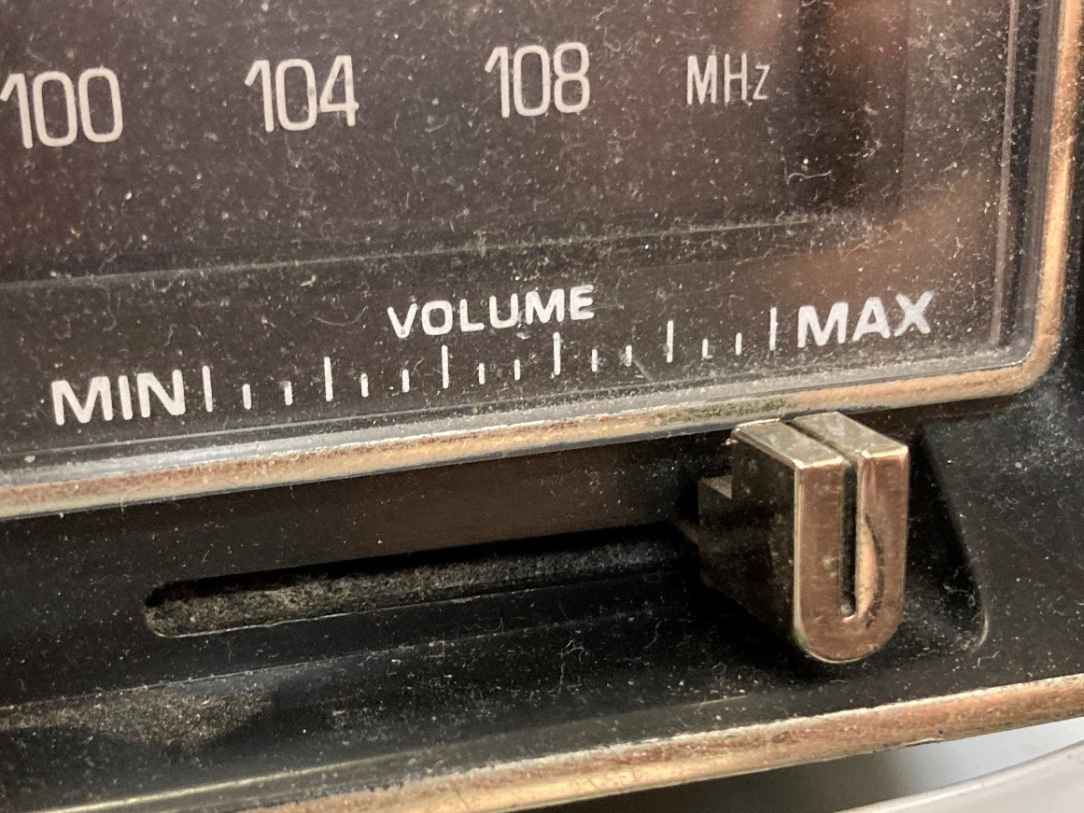
Automating Dependabot
Automatically hit that auto-merge button
Combined with auto-deployment, could mean some stuff gets updated without humans

Slide 18

Automating Dependabot - how
More YAML
Can only do this in some situations
Major/minor/patch
Security vulnerabilites

Slide 19
Reference Material

Slide 20
Recent Client Work
BC
Ask Basil
In the open
https://github.com/bcgov/greenfield-template
https://github.com/bcgov/startup-sample-project-aws-containers-terraform-modules
https://developer.gov.bc.ca/AWS-Services
https://developer.gov.bc.ca/Developer-Tools/Set-up-a-team-in-Sysdig-Monitor
https://developer.gov.bc.ca/Developer-Toy-Box/OpenShift-Components
Alberta
Service Integration’s GitHub CI/CD Framework
Includes deployment into OpenShift V3, more to follow
Ask Warren if you missed the town hall
Anything else?

Slide 21
Reference Links
GitHub Actions – https://docs.github.com/en/actions
Dependabot – https://docs.github.com/en/code-security/dependabot/dependabot-version-updates/about-dependabot-version-updates
Dependabot auto-approval – https://github.com/dependabot/fetch-metadata
GitHub CLI – https://cli.github.com/manual/
Writing actions
https://github.com/actions/toolkit
https://github.com/actions/typescript-action

Slide 22
Repositories
Main repo – https://github.com/warrenb-cgi/github-actions-talk
Workflow example – https://github.com/warrenb-cgi/github-actions-talk-features
Dependabot examples
https://github.com/warrenb-cgi/github-actions-talk-manual
https://github.com/warrenb-cgi/github-actions-talk-completed

Slide 23
Insights you can act on

